Slide 1
Title
Harris County Case Study
Tai Tony Tran
Data Scientist
taitran2002@hotmail.com

Slide 2
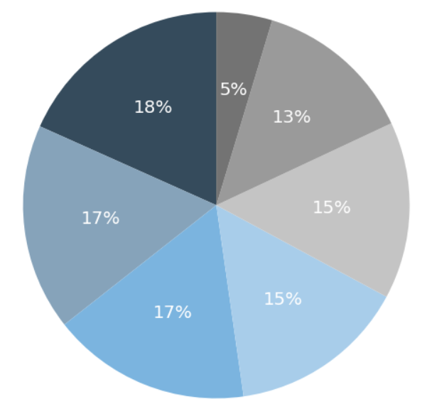
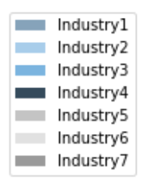
Client Sales Pipeline
Snapshot
Open
Closed Won
Close Lost
Total
Fiscal Year 2019 – 2020
Period 1 – 13
90,310,121,319
Total Sales
10,060,167,028
Total Sales
2,531,162,528
Total Sales
110,465,430,331
Total Sales
72,111
Count
25,947
Count
2,892
Count
107,536
Count
By Phase (Count)
By Industry
Phase 7 – 15,531
Phase 6 – 5,357
Phase 5 – 17,023
Phase 4 – 19,106
Phase 3 – 19,858
Phase 2 – 17,079
Phase 1 – 21,002

Slide 3
Which Products to Focus on Going Forward
Assumptions
each product sale creates the same amount of profit in USD
the company's metric for success is to maximize potential profit and sales
Key Takeaway
The client want to focus on products that maximize total
Weighted Sales and show positive growth trends over time.

Slide 4
Total Weighted Sales
Top 5 Total Weight Sales by Item
Item Id | 2019 | 2020 | Total Weighted Sales
1650 | 526,978,559 | 1,157,333,961 | 1,684,312,520
2061 | 591,734,150 | 572,925,520 | 1,164,659,670
1818 | 375,658,065 | 730,103,540 | 1,105,761,605
2004 | 403,860,361 | 535,241,533 | 939,101,895
1629 | 357,677,003 | 448,149,619 | 805,826,622
6015 | 21294 | 726 | 732 | 5943 | 5958
1266 | 801 | 1245 | 1233 | 15813 | 888
6051 | 6069 | 15438 | 1113 | 1092 | 1080
927 | 972 | 4647 | 4641 | 1680 | 657
25032 | 3198 | 3330 | 3387 | 24963 | 24918
4632 | 24768 | 3522 | 1839 | 3399 | 942
4629
These 37 Items have a
Weighted Sales of 0

Slide 5
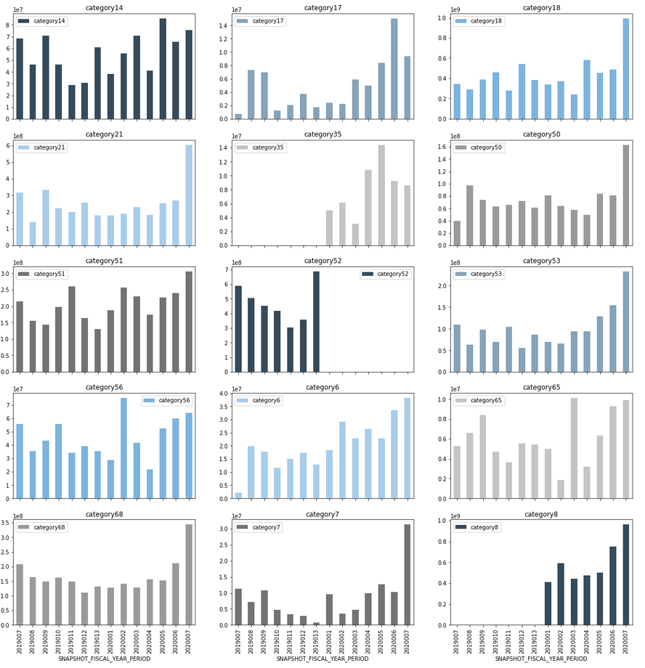
Highest Weighted Sales by Product_Category2_text
Item Id | Total Weighted Sales
category18 | 6,157,351,527
category8 | 4,125,766,049
category21 | 3,557,795,425
category52 | 3,307,325,336
category51 | 2,884,306,571
Categories 6, 7, 8, 14, 17, 18, 21, 35, 50, 51, 53, 56,65, 68 Show positive trends in this snapshot period.
Category 52 shows a negative trend despite the high total weighted sales.

Slide 6
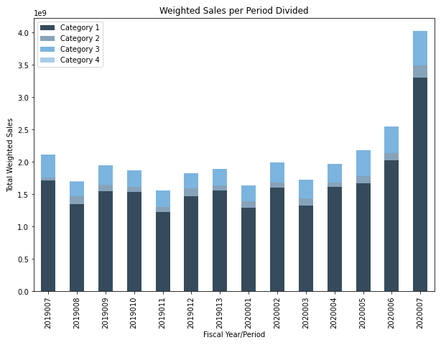
Weighted Sales Separated by Product Mapping Category
Product Mapping Category | Average Weighted Sales | Count
Category 1 | 429,069.83 | 54,137
Category 2 | 51,683.86 | 26,534
Category 3 | 166,354.94 | 26,338
Category 4 | 18,125.63 | 527
Products Mapped into Category 1 had the highest Average Weighted Sales and highest count

Slide 7
Which Customers and Opportunities to Focus on Going Forward
Client should focus on customers and opportunities that:
Customers with a high count of opportunities that are "Closed" and "Won"
Customers with a high total count of opportunities
Customers with a large total weighted sales
What region are our 'best' customers from?
What industry are our 'best' customers from?
Should we focus on new or returning customers?

Slide 8
Top 10 Customers by Total Weighted Sale
Customer Id | Total Weighted Sales | Average Weighted Sales | Total # of Opportunities | Ratio of Won Opportunities
24018057 | 706,857,769 | 2,272,854 | 311 | 83 / 311 = 26.69%
24048879 | 598,351,669 | 600,152 | 997 | 224 / 997 = 22.47%
24035370 | 539,739,707 | 2,230,329 | 242 | 45 / 197 = 22.84%
24000954 | 455,511,484 | 1,980,484 | 230 | 35 / 230 = 15.22%
24043533 | 453,132,380 | 1,562,525 | 290 | 58 / 290 = 20.00%
24041244 | 440,527,906 | 1,034,103 | 426 | 33 / 426 = 7.75%
24036867 | 438,592,695 | 861,675 | 509 | 97 / 509 = 19.06%
24028941 | 420,689,030 | 600,127 | 701 | 76 / 701 = 10.84%
24043992 | 410,096,490 | 1,419,018 | 289 | 33 / 289 = 11.42%
24000882 | 394,500,355 | 1,860,850 | 212 | 35 / 212 = 16.51%

Slide 9
Customer Info
New Clients
Client Type | Weighted Sales 2019 | Weighted Sales 2020 | % Change
New Customer | 6,056,427,215 | 7,340,227,356 | 121.20%
Returning Customer | 6,850,818,411 | 8,743,468,655 | 127.63%
Client should focus on customers from Industry 4 and US – East, due to a drastic difference in historic total weighted sales
Both new customers and returning customers are have shown growth between 2019 and 2020.
All Industries grew between 2019 and 2020.
Only US – West decreased in total weighted sales between 2019-2020
Industry
Industry | Weighted Sales 2019 | Weighted Sales 2020 | % Change
Industry 1 | 1,433,774,372 | 2,184,317,648 | 152.35%
Industry 2 | 1,385,092,325 | 2,017,925,436 | 145.69%
Industry 3 | 1,154,204,501 | 1,336,945,558 | 115.83%
Industry 4 | 6,097,531,388 | 7,413,050,831 | 121.57%
Industry 5 | 1,613,699,515 | 1,662,796,085 | 103.04%
Industry 6 | 130,603,825 | 183,868,475 | 140.78%
Industry 7 | 1,092,339,696 | 1,284,791,974 | 117.62%
Region
Region | Weighted Sales 2019 | Weighted Sales 2020 | % Change
US - East | 7,469,171,098 | 9,163,566,295 | 122.69%
US - Central | 3,274,365,969 | 4,772,158,877 | 145.74%
US - West | 1,966,580,583 | 1,863,201,604 | 94.74%
US – National Office | 197,127,974 | 284,744,234 | 144.45%

Slide 10
Machine Learning Predictions
Created a Random Forest Regressor model to predict Weighted Sales fit on columns such as:
Product category4 id | Opportunity id
Total sales | Customer sector
Fiscal year and period | Product Mapping Category
Customer industry | Region
Key takeaway
Metrics used to measure the accuracy of the model were mean absolute error and r².
An r² of 0.47 was recorded, meaning that 47% of the variance in the data are explained by the model created.
A higher r² means a more accurate model, therefore a r² of 47% is good, however, it could be improved with more data and other features not included.

Slide 11
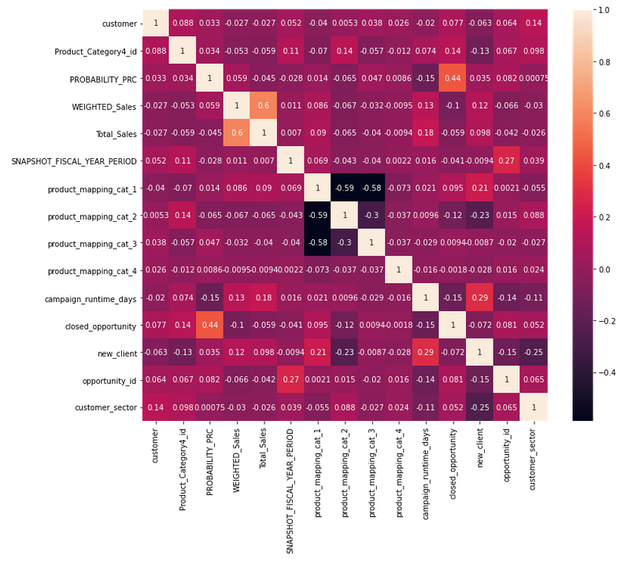
Correlation Heatmap
There are no strong positive or negative correlation for Weighted Sales and other columns to use for machine learning predictions.

Slide 12
Where has the client seen the most success?
The client has seen the most success with the growth of its new and recurring customer base in all recorded industries and most regions.
The client has seen the largest percentage of growth with recurring customers, for customers in Industry 1, and customers in US – East.
Client has seen the most success with Product_Category4_id of 1650; not only does it have the highest total weighted sales, it has the highest increase in weighted sales over a 200% increase from 2019 to 2020

Slide 13
Appendix
1. | index = customer_model_df.groupby('Product_Category4_id')['WEIGHTED_Sales']\ .sum().sort_values(ascending=False).head().index customer_model_df[customer_model_df['Product_Category4_id'].isin(index)]\ .groupby(['fiscal_year', 'Product_Category4_id'])['WEIGHTED_Sales'].sum()
2. | customer_model_df.groupby(['SNAPSHOT_FISCAL_YEAR_PERIOD', 'Product_Category2_text'])\ ['WEIGHTED_Sales'].sum().sort_values(ascending=False).unstack()\ .plot(kind='bar', stacked=False, figsize=(15,100),\ subplots=True, layout=(24,2), color=colors) plt.title('Weighted Sales per Period Divided') plt.xlabel('Fiscal Year/Period') plt.ylabel('Total Weighted Sales') plt.show()

Slide 14
Appendix
3. | temp_df.groupby(['SNAPSHOT_FISCAL_YEAR_PERIOD', 'product_mapping_category'])['WEIGHTED_Sales']\ .sum().unstack().plot(kind='bar', stacked=True, figsize=(10,7),\ color=colors) plt.title('Weighted Sales per Product Mapping Category') plt.legend(['Category 1', 'Category 2', 'Category 3', 'Category 4']) plt.xlabel('Fiscal Year/Period') plt.ylabel('Total Weighted Sales') plt.show()
4. | customer_model_df.groupby(['fiscal_year', 'new_client'])['WEIGHTED_Sales'].sum() customer_model_df.groupby(['fiscal_year', 'customer_INDUSTRY_DESC'])['WEIGHTED_Sales'].sum() customer_model_df.groupby(['fiscal_year', 'customer_REGION_DESC'])['WEIGHTED_Sales'].sum()
5. | reg_rfor = make_pipeline( OneHotEncoder(handle_unknown='ignore'), SimpleImputer(strategy='most_frequent'), RandomForestRegressor(n_estimators=75, random_state=0, n_jobs=4)) reg_rfor.fit(X_train, y_train) y_pred3 = reg_rfor.predict(X_test) error3 = mean_absolute_error(y_test, y_pred3) r2_3 = r2_score(y_test, y_pred3) print(error3) print(r2_3)

Slide 15
Appendix
6. | plt.subplots(figsize=(12,10)) sns.heatmap(customer_model_df.corr(),annot=True) plt.show()
FULL JUPYTER NOTEBOOK | This project was coded in Python in a Jupyter Notebook. All my code can be found at the following github link: https://github.com/TonyTranPortfolio/Portfolio/blob/main/Harris%20County%20Case%20Study/Notebook/Harris%20County%20Data%20Analytics%20Case%20Study.ipynb

